Slide 1
MAPREDUCE WITH COMBINER

Slide 2
MAPREDUCE WITH COMBINER
The programmer needs only to
  The Mapper
  The Reducer
  Combiner and Partitioner ( Optionally)
All other aspects of execution are handled transparently by the execution framework
  Cluster range
  Data size range
Synchronization is perhaps the most tricky aspect of designing MapReduce algorithms
Other than embarrassingly-parallel problems, processes running on separate nodes in a cluster must, at some point in time, come together

Slide 3
MAPREDUCE WITH COMBINER
Cluster-wide synchronization can be taken place at only one point in a single Map- Reduce job. i.e
  During the shuffling and sorting stage where intermediate key-value pairs are copied from the mappers to the reducers and grouped by key.
Beyond that, mappers and reducers run in isolation without any mechanisms for direct communication

Slide 4
MAPREDUCE WITH COMBINER
The programmer has little control over many aspects of execution,
  Where the mapper or reducer runs (which node in a cluster)
  When a mapper or reducer begins or finishes
  Which input key-value pairs are processed by a specific mapper
The programmer does have a number of techniques for controlling execution and managing the flow of data in MapReduce.
.

Slide 5
MAPREDUCE WITH COMBINER
The programmers have a number of techniques for controlling execution and managing the flow of data in MapReduce
  The ability to construct complex data structures as keys and values to store and communicate partial results.
  The ability to execute user-specified initialization code at the beginning of a map or reduce task, and the ability to execute user-specified termination code at the end of a map or reduce task
  The ability to preserve state in both mappers and reducers across multiple input or intermediate keys.
  The ability to control the sort order of intermediate keys, and therefore the order in which a reducer will encounter particular keys
  The ability to control the partitioning of the key space, and therefore the set of keys that will be encountered by a particular reducer

Slide 6
MAPREDUCE WITH COMBINER
Many algorithms can not be expressed as a single MapReduce job.
So Decompose the complex algorithm into a sequence of jobs, which requires orchestrating data → the output of one job give as a input to the next job. (Iterative Algorithms).
Local Aggregation:
  In Hadoop, intermediate results are written to local disk before being sent over the network.
  Since network and disk latencies are relatively expensive compared to other operations, reductions in the amount of intermediate data translate into increases in algorithmic efficiency.

Slide 7
MAPREDUCE WITH COMBINER
Local aggregation of intermediate results is one of the keys to efficient algorithms in mapreduce.
Through use of the combiner and by taking advantage of the ability to preserve state across multiple inputs, it is often possible to substantially reduce both the number and size of key-value pairs that need to be shuffled from the mappers to the reducers.

Slide 8
MAPREDUCE WITH COMBINER
Local Aggregation Techniques:
  Combiner
  Associate
  Combiner Functionality inside of Mapper
Illustrating these techniques with help of simple word count example

Slide 9
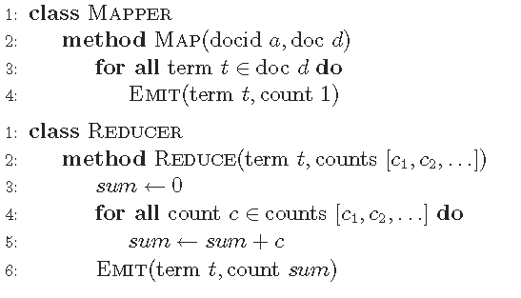
MAPREDUCE WITH COMBINER
Pseudo-code for the basic word count algorithm in MapReduce (Repeated)

Slide 10
MAPREDUCE WITH COMBINER
The Mapper emits an intermediate key-value pair for each term observed, with the term itself as the key and a value of one.
The Reducers sum up the partial counts to arrive at the final count.
First Technique: Combiner
  Combiners provide a general mechanism within the MapReduce framework to reduce the amount of intermediate data generated by the mappers.
  These can be treated as “Mini - Reducers” → It process the output of Mappers.
  In this example, the combiners aggregate term counts across the documents processed by each map task.

Slide 11
MAPREDUCE WITH COMBINER
First Technique: Combiner
  This results in a reduction in the number of intermediate key-value pairs that need to be shuffled across the network → from the order of total number of terms in the collection to the order of the number of unique terms in the collection
Associative Array in Mapper:
  It is introduced inside the mapper to tally up term counts within a single document: instead of emitting a key-value pair for each term in the document, this version emits a key-value pair for each unique term in the document.
  Given that some words appear frequently within a document, this can yield substantial savings in the number of intermediate key-value pairs emitted, especially for long documents.

Slide 12
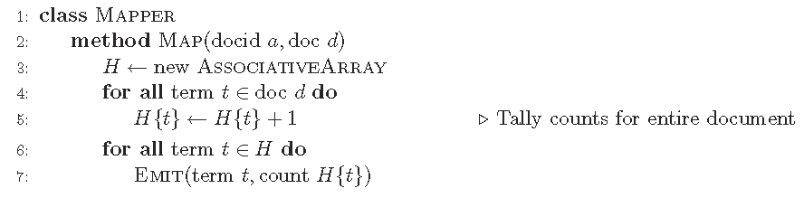
MAPREDUCE WITH COMBINER
Pseudo-code for Improve word count algorithm using Associate Array to aggregate term counts on a per-document basis

Slide 13
MAPREDUCE WITH COMBINER
Another Variant of the Basic word count Algorithm: (In-Mapper Combining)
  Prior to processing any input key-value pairs, the mapper's Initialize method is called, which is an API hook for user-specified code.
  Initialize an associative array for holding term counts.
  Since it is possible to preserve state across multiple calls of the MAP method, we can continue to accumulate partial term counts in the associative array across multiple documents, and emit key-value pairs only when the mapper has processed all documents.
  i.e emission of intermediate data is deferred until the CLOSE method in the pseudo-code.
  This API hook provides an opportunity to execute user-specified code after the Map method has been applied

Slide 14
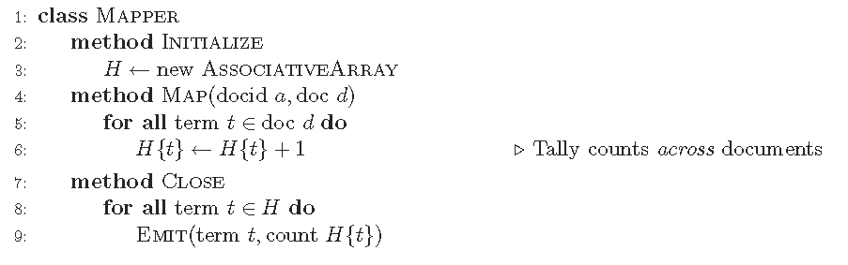
MAPREDUCE WITH COMBINER
Pseudo-code for Improved MapReduce word count algorithm using In-Memory Combining

Slide 15
MAPREDUCE WITH COMBINER
Hadoop Combiner is an optional, it may or may not applied to program during execution.
In-mapper combining will typically be more efficient than using actual combiners.
ALGORITHMIC CORRECTNESS WITH LOCAL AGGREGATION:
  Although use of combiners can yield dramatic reductions in algorithm running time, care must be taken in applying them.

Slide 16
MAPREDUCE WITH COMBINER
ALGORITHMIC CORRECTNESS WITH LOCAL AGGREGATION:
Example:
  we have a large dataset where input keys are strings and input values are integers, and we wish to compute the mean of all integers associated with the same key (rounded to the nearest integer).

Slide 17
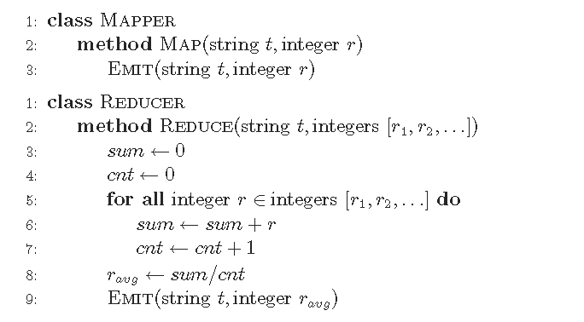
MAPREDUCE WITH COMBINER
Pseudo-code for the basic MapReduce algorithm that computes the mean of values
associated with the same key.

Slide 18

MAPREDUCE WITH COMBINER
Example:
  Mapper, which simply passes all input key-value pairs to the reducers.
  The reducer keeps track of the running sum and the number of integers encountered.
  This information is used to compute the mean once all values are processed.
  The mean is then emitted as the output value in the reducer.
  The reducer cannot be used as a combiner in this case.
  Assume Combiner: the combiner would compute the mean of an arbitrary subset of values associated with the same key, and the reducer would compute the mean of those values.

Slide 19
MAPREDUCE WITH COMBINER
Example:
  Simple case:
  In general, the mean of means of arbitrary subsets of a set of numbers is not the same as the mean of the set of numbers.
  Therefore, this approach would not produce the correct result.

Slide 20
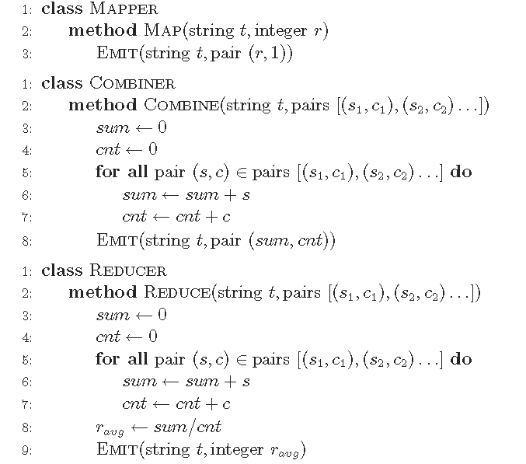
MAPREDUCE WITH COMBINER
Pseudo-code for a MapReduce algorithm that computes the mean of values associated with each key

Slide 21
MAPREDUCE WITH COMBINER
Example:
  In the mapper we emit as the value a pair consisting of the integer and one -- this corresponds to a partial count over one instance.
  The combiner separately aggregates the partial sums and the partial counts, and emits pairs with updated sums and counts.
  The reducer is similar to the combiner, except that the mean is computed at the end.
  In essence, this algorithm transforms a non-associative operation into an associative operation.

